Slide 1



















Coffee Data Analysis Project
From Raw Data to Business Insights
By: Makhloufi Mahdi
2025-09-19
Data Cleaning
SQL Analysis
PySpark
Dashboards

Slide 2














Coffee Data Analysis Project
From Raw Data to Business Insights
Project Overview
Data Cleaning (Alteryx)
SQL Analysis
Converted storeID and productID to integers
Weekly revenue trends
Removed unknown/irrelevant columns
Top-performing products & stores
Cleaned whitespace, tabs, and line breaks
Quantity sold by category
Ensured data consistency for further analysis
Pareto Analysis: 20% of products generate ~80% of revenue
PySpark Analysis
Looker Studio Dashboards
Sales trends & KPIs
Weekly revenue trends
Correlation matrix (price, sales, categories)
Average basket value
Regression analysis (predicting revenue)
Revenue by category
Time series analysis for forecasting
Interactive filters (product, category, location, date)
Coffee Data Analysis Project

Slide 3



















Coffee Data Analysis Project
From Raw Data to Business Insights
Data Cleaning (Alteryx)
Data Type Conversion
Column Removal
Text Data Cleansing
Converted key columns to appropriate data types:
Identified and removed irrelevant data:
Standardized text fields by removing:
Unknown columns with no business value
Leading/trailing whitespace
storeID: Text → Integer
Redundant information
Tabs and line breaks
productID: Text → Integer
Irrelevant to analytical objectives
Ensured uniformity for aggregation
Enabled accurate joins and numerical operations
Results
The data cleaning process transformed the raw coffee sales data into a consistent, standardized format. This ensured accuracy and reliability for subsequent analysis stages, including SQL queries and PySpark modeling.
Coffee Data Analysis Project

Slide 4






















Coffee Data Analysis Project
From Raw Data to Business Insights
SQL Analysis (Key Insights)
Weekly Revenue Trends
Top-Performing Products
Analysis of sales data aggregated by week reveals distinct patterns, with notable revenue peaks during specific periods.
The following products consistently rank as top revenue generators:
Strong peak: Jan 7–9 (possibly special event/promotion)
Latte Rg
Latte
Cappuccino
Low points: Jan 13 & 25 (slow sales days)
Brazilian Coffee
Sustainable Coffee
Quantity Sold by Category
Pareto Analysis
Analysis of sales volumes across different product categories reveals:
Application of the 80/20 rule reveals:
Coffee: Core business driver
~20% of products generate ~80% of total revenue
Bakery & Chocolate: Strong cross-sell items
Beans: Niche market for loyal customers
Coffee Data Analysis Project

Slide 5













Coffee Data Analysis Project
From Raw Data to Business Insights
PySpark Analysis
Advanced analytical modeling for large-scale coffee sales data
Sales Trends & KPIs
Correlation Matrix
Analysis of sales trends and calculation of key performance indicators (KPIs) to provide a comprehensive overview of business performance.
Generation of a correlation matrix to understand the relationships between various factors such as price, sales volume, and product categories.
Monthly baseline revenue: €81,700
Average basket size: €4.72
Regression Analysis
Time Series Analysis
Development of a regression model to predict future revenue based on historical data and identified influencing factors.
Application of time series models for forecasting future sales, enabling better planning for stock and staffing requirements.
Model identifies key drivers of revenue
Enables data-driven forecasting
Coffee Data Analysis Project

Slide 6



























Coffee Data Analysis Project
From Raw Data to Business Insights
Looker Studio Dashboards
Weekly Revenue
Filters:
Latte
HK
Average Basket
Filters:
Cappuccino
Interactive dashboards transforming coffee sales data into actionable business insights.
Key Features:
Transform raw data into visual insights
Interactive filters for customization
Revenue: €81,700
Weeks: Jan-Apr
Average: €4.72
Products: 80
Responsive design for all devices
Benefits:
Revenue by Category
Filters:
Jan
Top Products
Filters:
NY
Empower decision-makers with data
Identify trends and opportunities
Latte Rg
Latte
Track KPIs in real-time
€12.50
€10.50
Cappuccino
Brazilian Coffee
€9.50
€8.50
Coffee: 65%
Bakery: 20%
Coffee Data Analysis Project

Slide 7



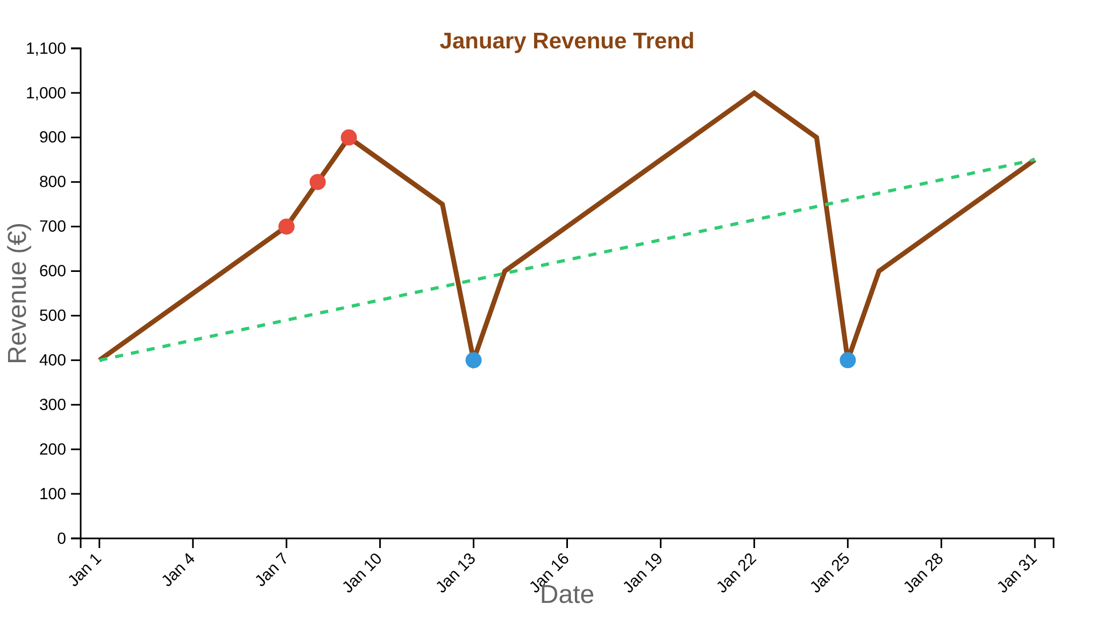








Coffee Data Analysis Project
From Raw Data to Business Insights
Revenue Over Time
Key Revenue Peaks
January 7-9:Notable revenue surge, possibly linked to special event or promotion
Daily peaks: €1,500 (Jan 9), €1,200 (Jan 8), €800 (Jan 7)
Low Sales Periods
January 13 & 25:Consistent low sales days, identified as slow sales periods
Monthly Trend Analysis
Overall growth:January shows continuous growth within the month
Revenue Peaks
Low Sales Days
Overall Growth Trend
Seasonal effect:January/February represents lowest sales months, while June shows highest sales
Coffee Data Analysis Project

Slide 8




























Coffee Data Analysis Project
From Raw Data to Business Insights
Sales by Product
Top Revenue-Generating Products
Key Insights
Latte Rg
Strong preference for traditional and gourmet coffee drinks
Regular latte with classic espresso
"Coffee" remains the core business driver
Latte
Standard latte with steamed milk
Pareto analysis shows 20% of products generate ~80% of revenue
Cappuccino
Equal parts espresso and steamed milk
Implications
Brazilian Coffee
Focus marketing on top-performing products
Single-origin coffee from Brazil
Consider bundling coffee with bakery items for cross-selling
Sustainable Coffee
Ethically sourced coffee blend
Coffee Data Analysis Project

Slide 9










Coffee Data Analysis Project
From Raw Data to Business Insights
Revenue by Category
Coffee
Bakery & Chocolate
Beans
Primary Driver
Strong Cross-Sell
Niche Market
The core business, consistently generating the highest revenue across all locations.
High-performing complementary categories that benefit from coffee purchases.
Serves specialty customers seeking premium coffee products.
Coffee Data Analysis Project

Slide 10











Coffee Data Analysis Project
From Raw Data to Business Insights
Product Performance Insights
Top Performers
Entry Products
Barista Espresso:
Brewed Teas:
Top-selling product with strong revenue
High sales volume but low margins
High customer preference item
Positioned as entry products to attract customers
Margin Opportunities
Repositioning Needs
Biscotti:
Black/Chai Tea & Clothing:
Low sales but excellent margins
Black/Chai Tea: Very low sales but premium price
Promotion potential through combos
Clothing: Branded items with low sales need repositioning
Strategic Implications
Promote Biscotti through combo offers
Develop new "Drinking Chocolate" offerings
Consider premium positioning for Barista Espresso
Reassess Clothing product strategy
Coffee Data Analysis Project

Slide 11


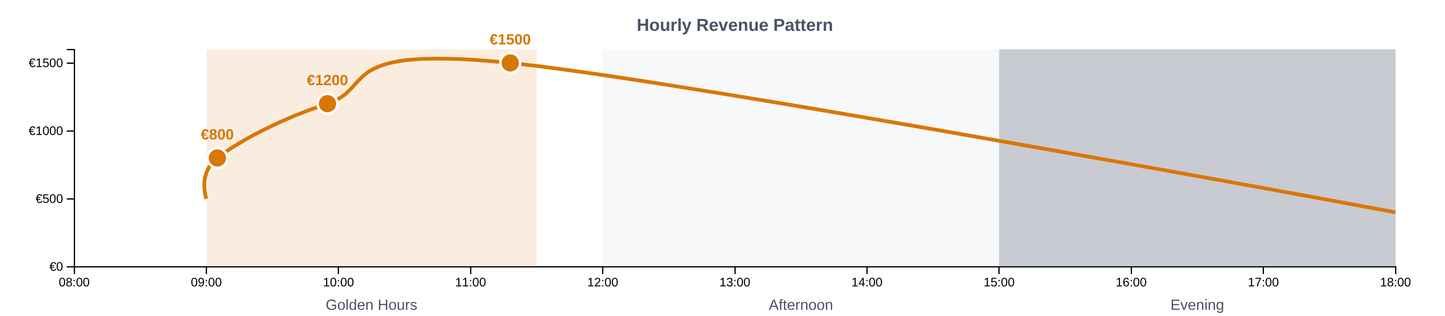



Coffee Data Analysis Project
From Raw Data to Business Insights
Revenue by Hour
Key Revenue Peaks
Sales Patterns
11:18:€1,500
Morning (09:00-11:30):"Golden hours" with strong revenue
09:55:€1,200
Afternoon:Very low sales
09:05:€800
Evening:Moderate to low sales
Business Implications
The morning peak suggests a strong coffee culture in the local area. The late morning/early afternoon drop indicates a need for new product offerings or promotions to maintain customer interest.
Coffee Data Analysis Project

Slide 12


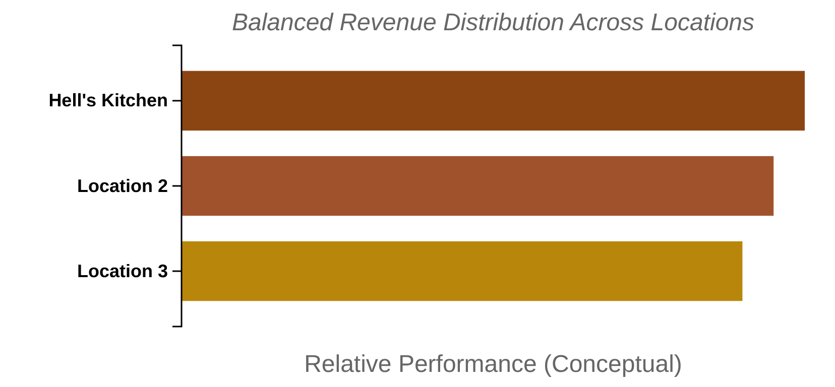







Coffee Data Analysis Project
From Raw Data to Business Insights
Revenue by Location
Store Performance Comparison
Key Insights
All three store locations show abalanced revenue distribution, indicating consistent business performance across the board.
Hell's Kitchenlocation slightly leads in overall revenue, suggesting it could serve as a benchmark for operational best practices.
Theconsistent performanceacross stores indicates an effective standardized business strategy that can be replicated across all locations.
Hell's Kitchen
Location 2
Location 3
Slight Leader
Balanced Performance
Consistent With Others
Coffee Data Analysis Project

Slide 13


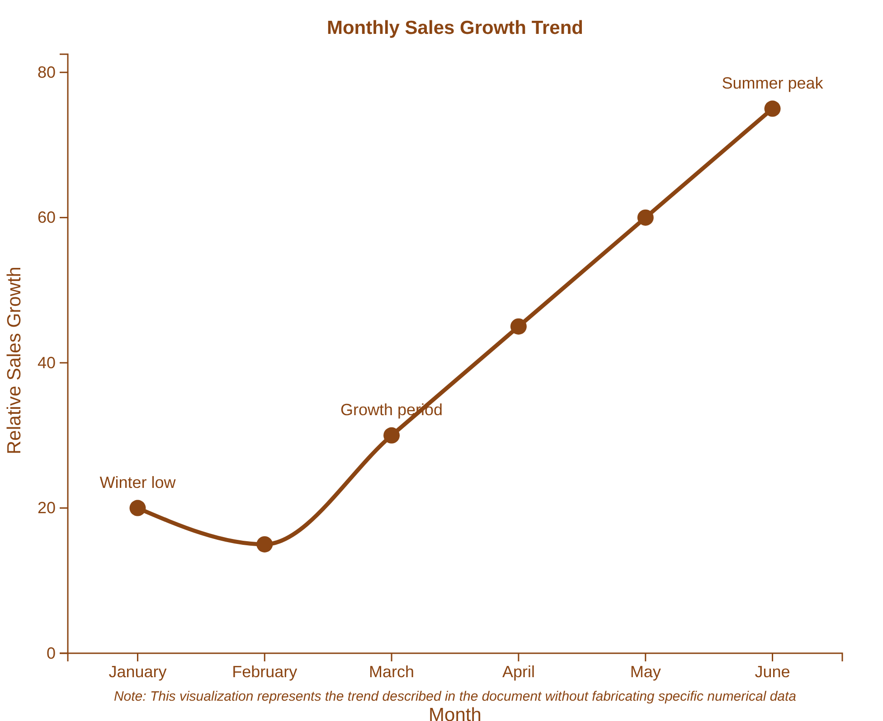




Coffee Data Analysis Project
From Raw Data to Business Insights
Monthly Sales Trends
Key Trends
Growth Period:Continuous growth observed from February through June
Peak Performance:June recorded the highest sales month
Low Season:January and February showed the lowest sales
Seasonality:Clear seasonal effect with sales typically lowest in winter months
Strategic Implications
Consider targeted marketing for winter months to boost sales
Prepare for increased demand in spring/summer periods
Develop seasonal product variations to address changing preferences
Coffee Data Analysis Project

Slide 14












Coffee Data Analysis Project
From Raw Data to Business Insights
Key Performance Indicators
Monthly Revenue
Average Basket Size
Unique Products
€81,700
€4.72
80
Baseline monthly revenue
Average transaction value
Distinct items in our menu
These KPIs provide a foundation for analyzing coffee sales performance
Coffee Data Analysis Project

Slide 15












Coffee Data Analysis Project
From Raw Data to Business Insights
Strategic Recommendations
Target Off-Peak Periods
Strengthen Cross-Selling
Implement focused marketing campaigns during slow sales days (mid-month, afternoons, Saturdays) to stimulate demand and balance customer traffic.
Capitalize on coffee as a core driver by actively promoting cross-selling with high-performing complementary categories like bakery and chocolate.
Example: "Happy Hour" discounts in the late afternoon to attract new customers
Bundle coffee with bakery items or offer combo deals to increase average basket value
Optimize Product Promotion
Enhance Operations
Promote products with good margins but lower sales, such as Biscotti and premium teas, through attractive combos or prominent placement.
Utilize time series analysis and sales forecasts to optimize stock levels and staffing schedules, minimizing waste and maximizing service quality.
For high-volume, low-margin items like Brewed Teas, consider strategies to improve profitability
Leverage Hell's Kitchen best practices across other stores to ensure consistent performance
Expand "Drinking Chocolate" Offerings
Given the popularity of "Hot Chocolate" within the "Drinking Chocolate" category, consider expanding the product line to include more chocolate-based items, tapping into an emerging consumer interest.
Coffee Data Analysis Project

Slide 16








Coffee Data Analysis Project
From Raw Data to Business Insights
Conclusion
This project successfully transformed raw coffee sales data into actionable business insights through a structured analysis pipeline. The key findings reveal valuable opportunities for business optimization.
Core Business Driver
Clear Sales Patterns
Coffee remains the core business driver, strongly supported by bakery and chocolate items, which present significant cross-selling opportunities.
Morning hours (09:00-11:30) represent "golden hours" for sales, with distinct patterns observed across days and months revealing opportunities for targeted marketing.
Consistent Store Performance
Business Optimization
All three store locations demonstrated consistent performance, with Hell's Kitchen showing a slight lead, suggesting a robust and replicable business strategy.
These insights are crucial for optimizing inventory management, refining marketing strategies, and fostering sustainable revenue growth through data-driven decision-making.
Key Insight
The analysis pipeline, from data cleaning to advanced modeling, demonstrates how transforming raw data into actionable insights can drive meaningful business growth and inform strategic decision-making.
Coffee Data Analysis Project

Slide 17











Coffee Data Analysis Project
From Raw Data to Business Insights
Thank You!
For questions or follow-up discussions about the coffee data analysis project
LinkedIn
GitHub
Email
Connect with me to discuss the project and explore further insights
Access the project repository and explore the data analysis code
Direct contact for questions about the coffee data analysis project
"From raw data to actionable business insights"
Coffee Data Analysis Project

